Slide 1

HealthCare: Stroke Prediction Problem
Abhishek Kumar
Zohreh Safari
Saranya Duggaraju
Jaichandra Sesetty
Patrice Fote Bipana Thapaliya
CS 5341 Pattern Recognition
December 5, 2018

Slide 2
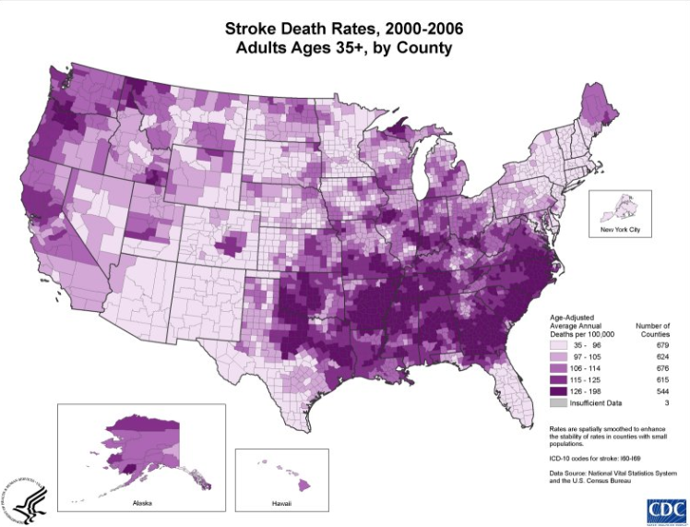

Background
A stroke occurs when parts of the brain suffer from insufficient oxygen supply.
Stroke is the fifth leading cause of death in the United States.
Death Toll: 140,000 Americans each year. 1 of every 20 deaths.

Slide 3

Outline
Introduction to Dataset
Basic data cleaning
Dealing with data types
Handling missing data
More data exploration
Outlier detection
Plotting distributions
Feature Engineering
Interaction between features
Dimensionality reduction using PCA
Feature selection and Model building
Comparison of different models performance

Slide 4
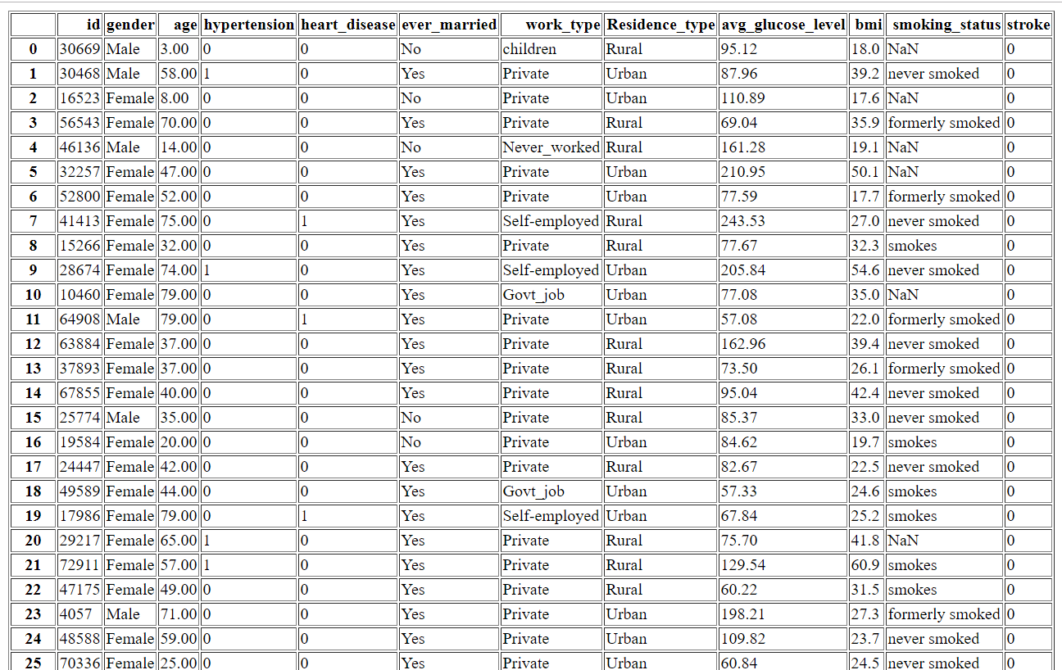
Introduction to Dataset
Kaggle URL
https://www.kaggle.com/asaumya/healthcare-dataset-stroke-data

Slide 5
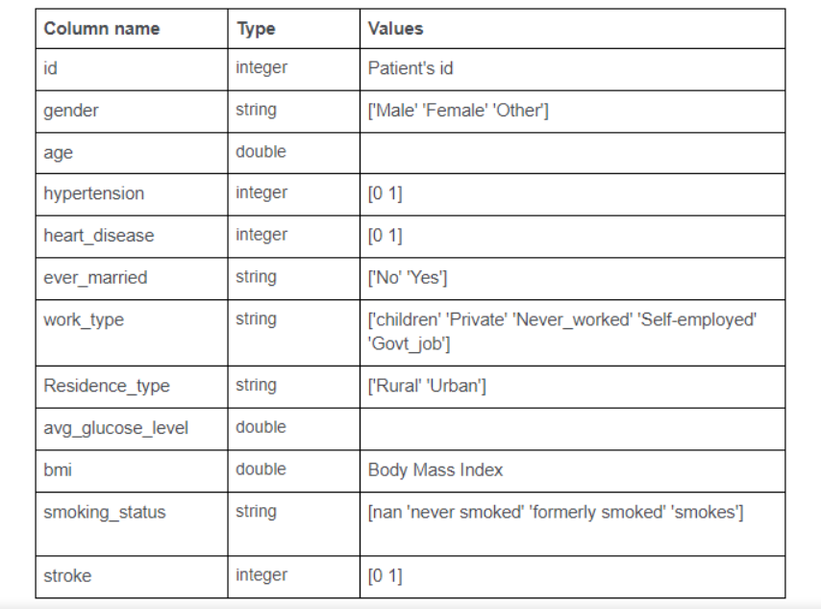

Dealing with data types

Slide 6
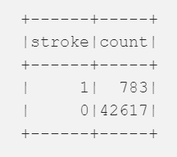
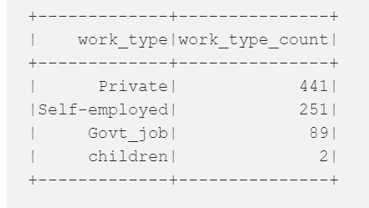
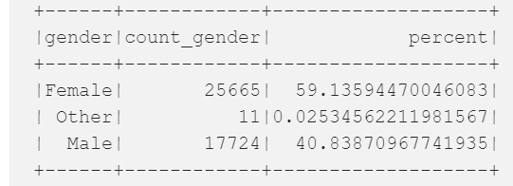
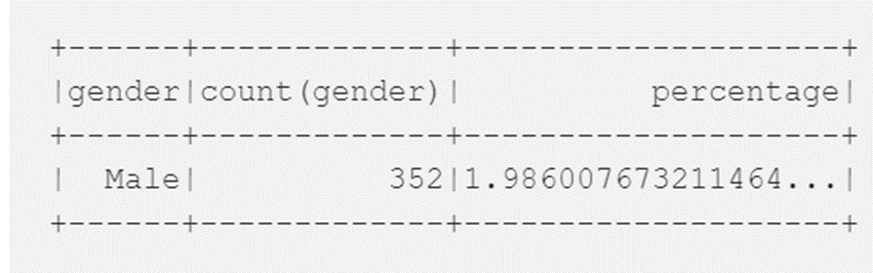
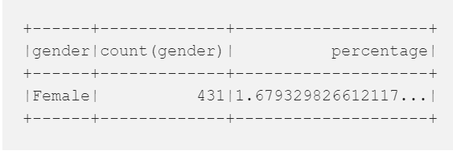
Data Set Analysis: People who have stroke
Only 783 people had stroke in this dataset
Private occupation is the most dangerous work type in this dataset.
59% of all people are Female and only 40% are Male that participated in stroke research.
2% Male have had a stroke.
1.68% Female have had a stroke.

Slide 7
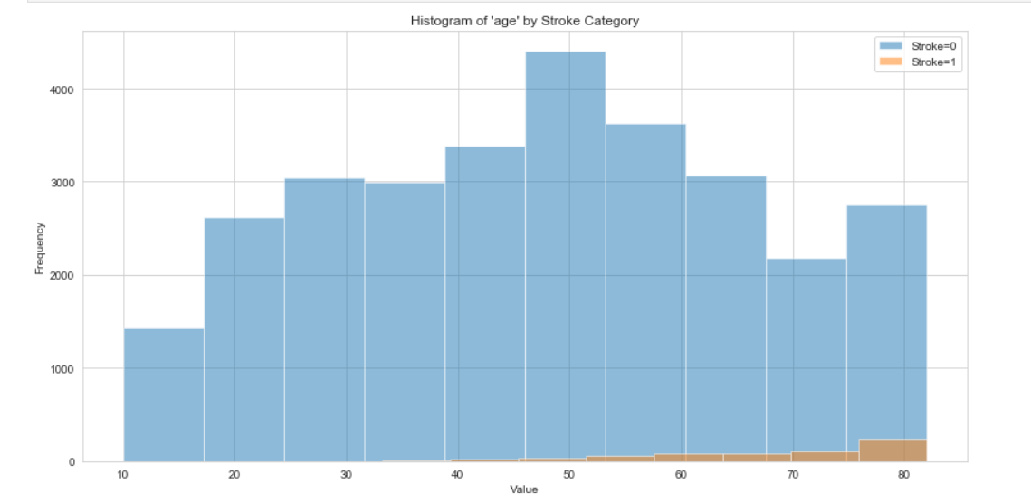
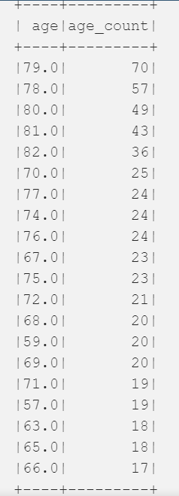
Important features study based on label
Conclusion: Age has an influence – an important risk factor for stroke.

Slide 8
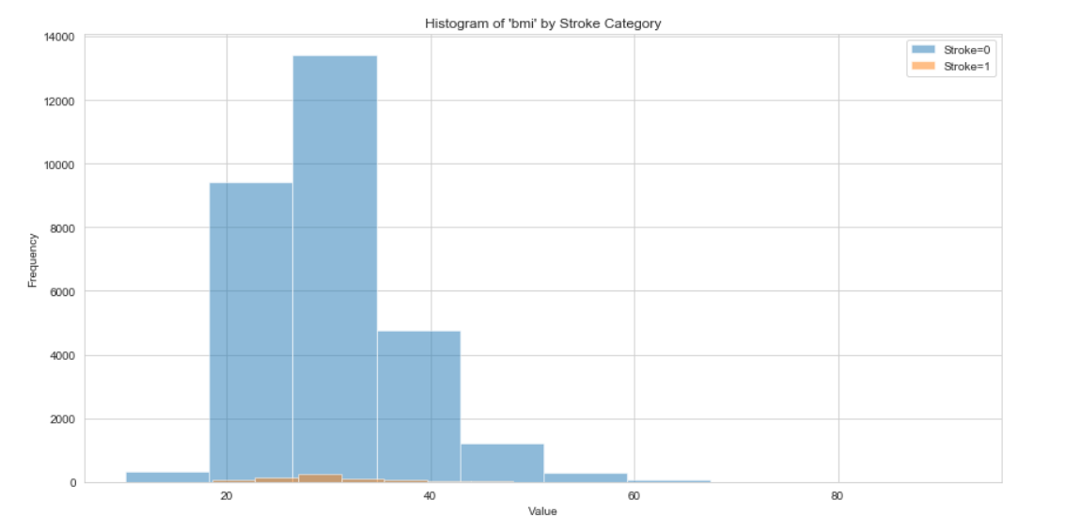
Important features study based on label

Slide 9
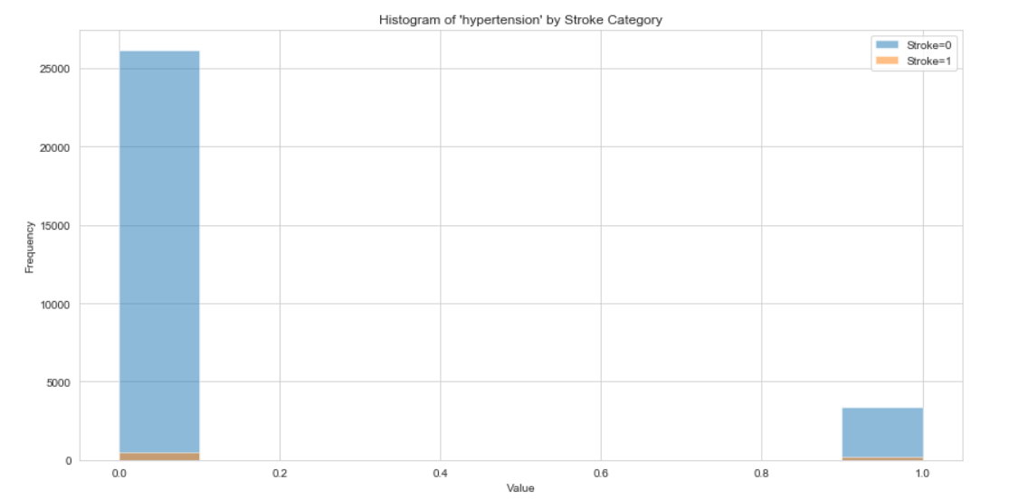
Important features study based on label

Slide 10
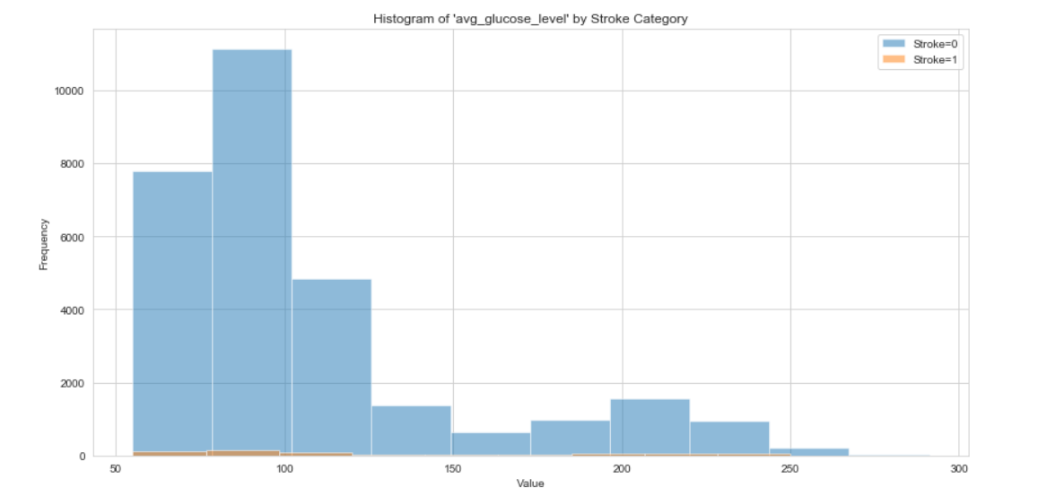
Important features study based on label

Slide 11
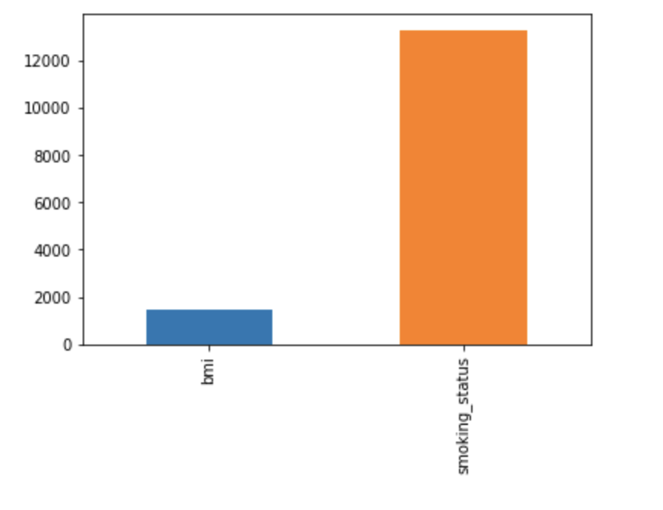
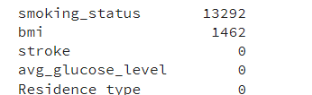
Data Cleaning
Smoking_status has very high missing values.
Followed using 2 dataframes.
Deleting those rows
Keeping those rows with encoding.
More to that later.

Slide 12

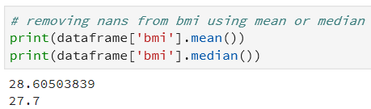
Handling Missing Data
BMI - mean and median almost same.
Selected mean to replace the values in the missing data.
Removed the id column to prevent overfitting.
A powerful classifier would use that column to fit perfectly on the training set.
Ignoring all the other columns, resulting in a useless model.

Slide 13

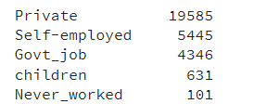
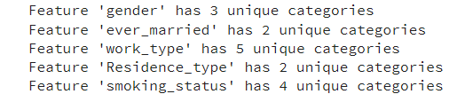
More to Data Cleaning
Most of the features had important categories, so we did not remove any of it.
Normalization using One Hot Encoder
Used one hot encoder to perform “binarization” of the category.
Include it as a feature to train the model.

Slide 14
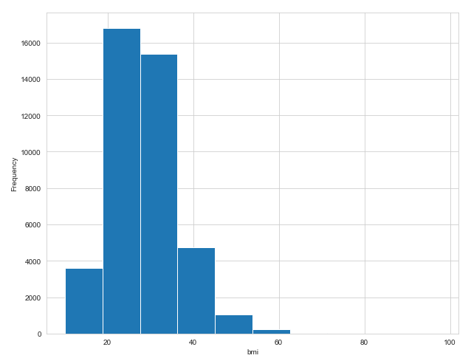
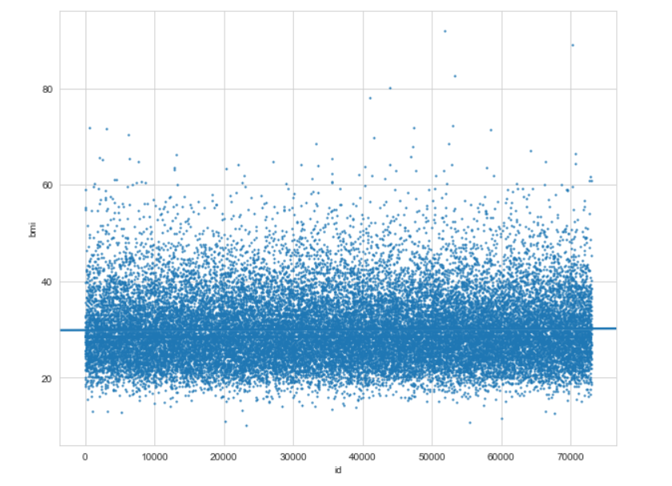
Data Exploration - 1
Histogram : Uncovering ‘bmi’ anomalies
Scatter Plot : Uncovering ‘bmi’ anomalies
Notes:
Scatter plots - There are no special techniques within the scatter plot that tell us that the points are outliers.
You have to use your intuition to analyze it.
BMI Range – underweight, normal weight, over weight, obese
Underweight, Normal weight Over weight, Obeses – BMI Range

Slide 15
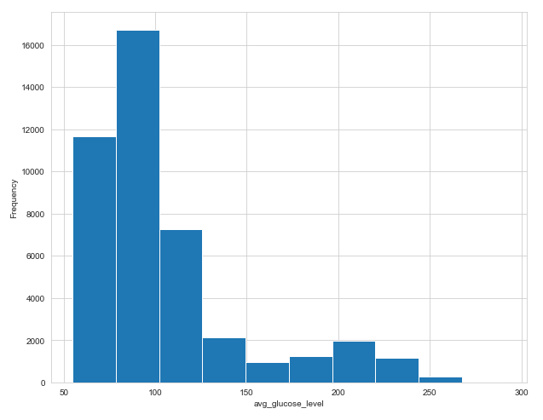
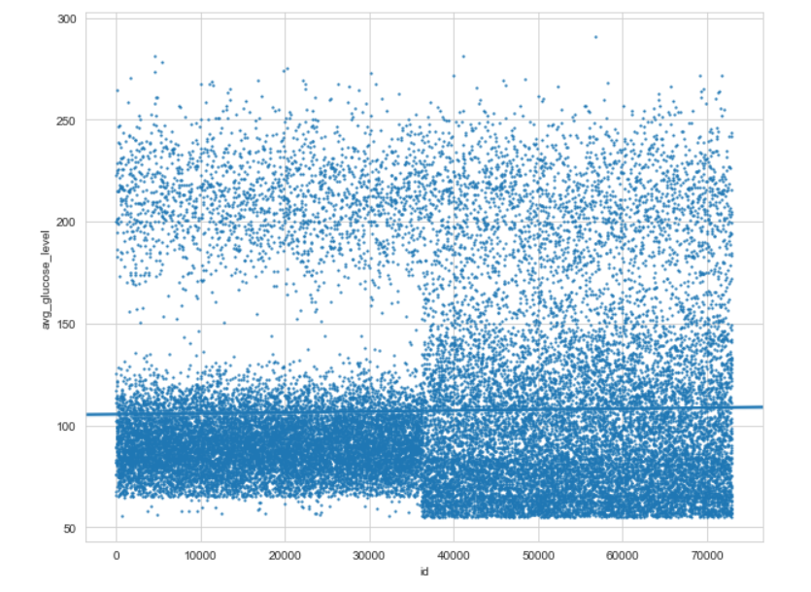
Data Exploration - 2
Histogram : Uncovering ‘avg_glucose_level’ anomalies
Scatter Plot : Uncovering ‘avg_glucose_level’ anomalies
Notes:
Avg Glucose Level 100 – 125 normal
160-240 is high risk of diabetes
Above 240 is dangerous
The better way is to analyze it using advanced statistics.

Slide 16
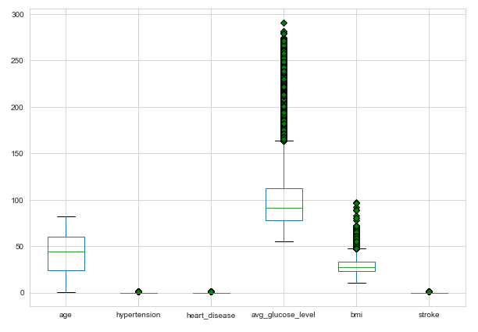
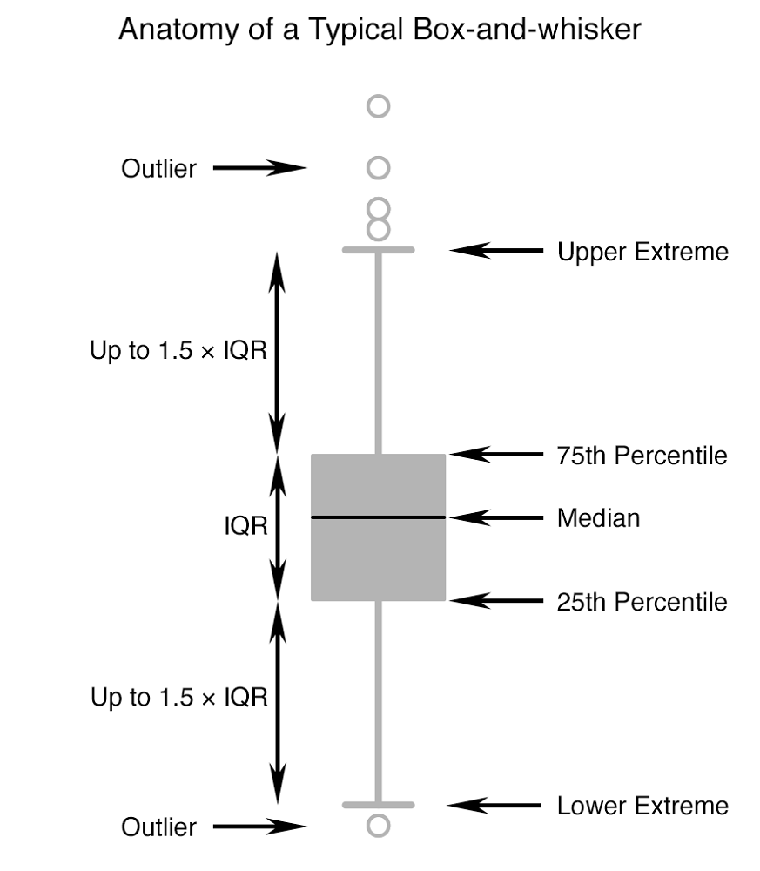
Outlier Detection
Tukey Boxplots
Notes:
Tukey Box plot help us to determine the unusually high and low data points
IQR shows a lot of our acg glucose level data are outliers – that is not true. We need such medical data.

Slide 17
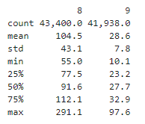
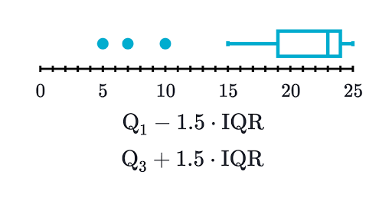
Outlier Analysis
AVG_GLUCOSE LEVEL
BMI
Tukey Outlier Labelling
Under the hood: Mathematical analysis of Tukey Outlier Detection Method
Notes:
Naturally occurring outlier – Mark Zuckerberg’s salary: Not necessarily problematic
Error – If you add extra 0’s while typing your weight: Can skew your model by affecting the slope
Kernel Density estimation

Slide 18
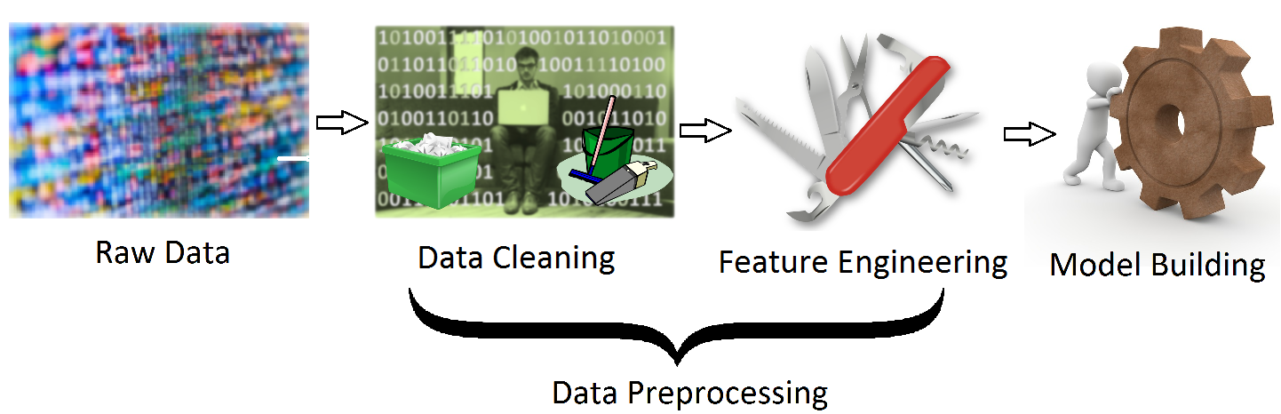
Feature Engineering – Interaction between features
Interaction among features
A simple two-way interaction is represented by:
X3 = X1 * X2, where X3 is the interaction between X1 and X2.
Interaction terms are useful for model if the impact of two or more features on the outcome is non-additive.
Interaction among dummy variables belonging to the same categorical feature are always zero.
We will calculate two-way interactions among all features.

Slide 19
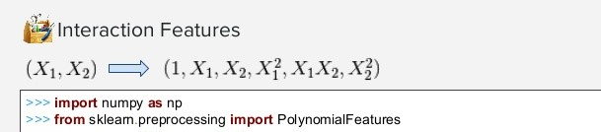
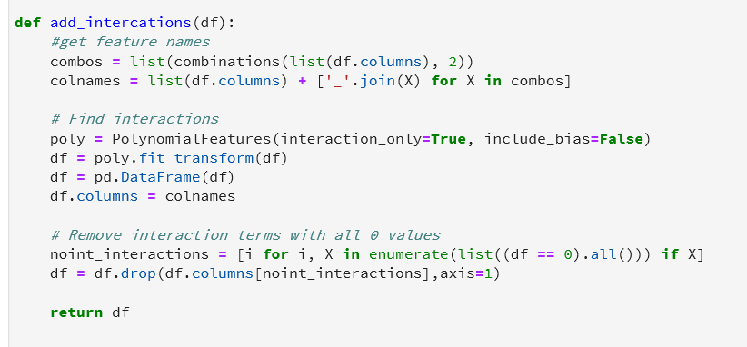
Features combinations
After feature combination, we ended up with 207 columns in our dataframe.
This might be computationally expensive → need to select features after this.

Slide 20
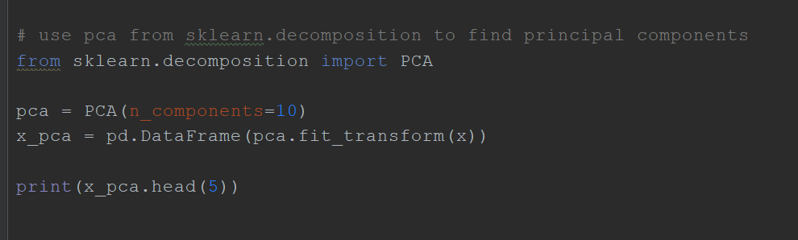
Dimensionality reduction using PCA
Better to perform when there are too many features or if observation/ feature ratio is poor.
Unfortunately, PCA makes models a lot harder to interpret.
We selected 10 components from PCA but we already had less features.
Because of imbalanced dataset we could not consider such a low number.

Slide 21
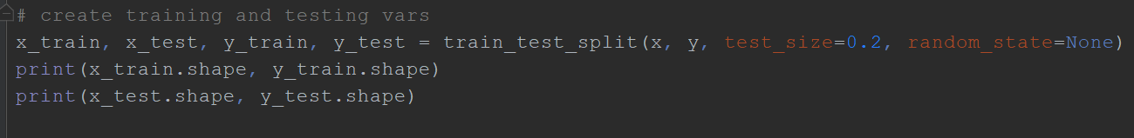
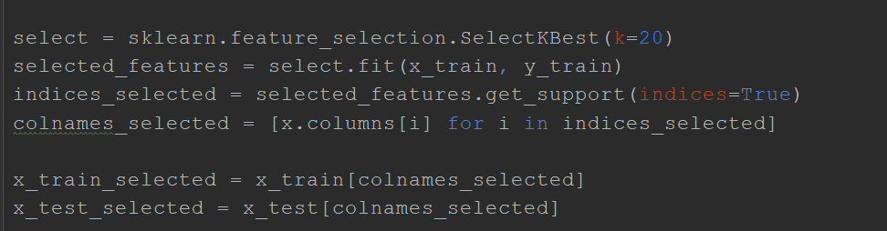
Train test split and feature selection
We divided 20% of our data into testing and 80% into training for modeling
Our large number of features can cause overfitting and slow computing,
→ selecting features using SelectKBest.

Slide 22

Algorithms for Modelling
Total data after preprocessing was:
30,108 from 43,400
Selected algorithms for classification
Decision tree
Random forest
Logistic Regression
XGBoost classifier
Application after balancing dataset
Key point to note: Imbalanced data: healthcare 0->42617 1->783

Slide 23
Performance metrics for different algorithms
Removing NaNs but without feature selection:
Results:
Calculated the number of samples for 1%, 10%, and 100% of the training data
Very good accuracy but misleading because of unbalanced dataset
 | Logistic Regression | Decision Tree | Random Forest
Train time | 16 sec | 14 sec | 24 sec
Training accuracy | 98% | 99% | 99%
Testing accuracy | 97% | 94% | 97%
F-train | 98% | 99% | 99%
F-test | 97% | 94% | 97%

Slide 24
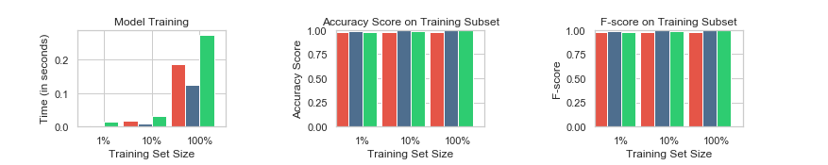
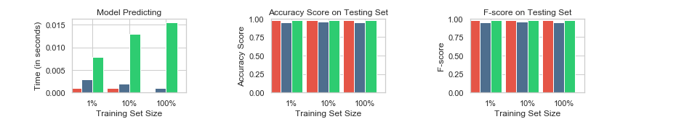
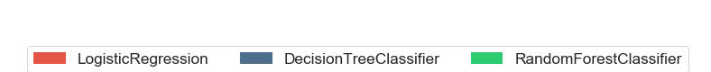
Performance metrics for 3 supervised learning models

Slide 25
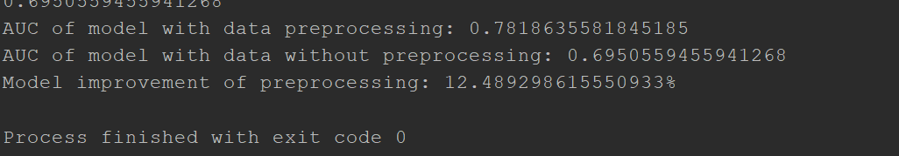
Performance metrics
With feature engineering:
With XGBoost Classifier:
Even XGBoost classifier gave us high percentage accuracy as other classifiers.

Slide 26
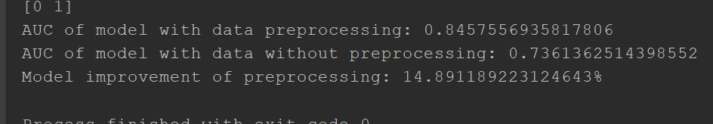
Making our dataset balanced
Stroke | Imbalaced | Balanced
0 | 42617 | 800
1 | 783 | 783
Evaluation results of balanced dataset

Slide 27

Conclusion and Future work
The best accuracy for our dataset was when we used a balanced dataset with feature selection.
Dealing with imbalanced datasets for better prediction:
Better classifiers or other tools
Collect more data
Apply SMOTE and MSMOTE methods

Slide 28


